Slide 1
Windows Server 2019
The operating system that bridges on-premises and Azure
Sarah Cooley
Elden Christensen

Slide 2
IT stress points
Legacy
systems
Disparate
systems
Rigid
solutions
Custom
solutions
required for compliance
Increased
security
exposure
Custom
solutions
required for interoperability
Increased complexity
Rising
costs
Notes:
We know IT is under a lot of pressure to continue to keep older systems working. This typically requires custom code and custom solutions, which lead to increasing complexity and – of course -- more expense.

Slide 3
68
Intelligent cloud
Intelligent edge
Notes:
Meanwhile, the future is with the Intelligent Cloud and the Intelligent Edge.
Based on the digital transformation work that Microsoft and its partners have been doing with customers across multiple industries, we see a real shift to a new way of thinking: ‘Intelligent Cloud and Intelligent Edge.’
We are seeing a big move to the cloud with our customers and its driving digital transformation and improving efficiency. They are able to take advantage of the latest AI technology and run global businesses at incredible scale with the help of the Intelligent Cloud.
While the cloud is critical to digital transformation, customers are also looking at how they can drive innovation and transformation at the edge; how they can transform their customers’ experience in a multi-device and multi-sense world, especially with the number of devices connecting to the Internet growing exponentially.
You have IoT, and multi-client, etc, you’ll still need to run apps and workloads in Windows Server on-premises or in the cloud. You can use Windows Server to evolve apps and infrastructure in the Intelligent Edge. (And your datacenter is a critical part of this).
Microsoft is committed to providing a connected experience across the cloud and edge – committed to giving you a consistent set of experiences when it comes to containers, security and management.

Slide 4
What organizations want:
Systems that distribute workloads seamlessly
It starts with an operating system that
bridges on-premises and cloud
Notes:
It’s clear that that hybrid is a very important part of many organizations’ digital strategy. They want to connect their current app + infra investments to public cloud.
Listen to what Satya Nadella said at a Q&A Session, April 2017
“Building applications for multi-device, multi-sense experiences is going to require a very different form of computing architecture. That’s the motivation for bringing together all of our systems people.
Silicon in the edge to silicon in the cloud, architected as one workload that is distributed—that’s the challenge in front of us.”

Slide 5
Customers embracing hybrid cloud
91%
87%
Enterprises have
a hybrid cloud
strategy, up from
55% a year ago¹
Enterprises see themselves
operating hybrid
clouds for the foreseeable future²
Organizations
are planning
to integrate
on-premises datacenters with
public cloud³
Sources:
Microsoft study, 2017
Microsoft study, 2017
Avanade research on IT modernization, April 2017
Notes:
In a recent survey over 80 percent of enterprise decision-makers told us that they see themselves operating in a hybrid environment. Hybrid cloud is the way all customers can be successful. So, how can you take advantage of this shift in technology?
Plotting your path to the cloud needs to be a key part of your IT strategy.
Many existing applications can move fast to cloud. Rarely does this happen overnight, so in most cases people will need to manage a couple of environments.
The question becomes how best to connect new cloud technologies with the substantial investments you’ve made in your on-premises datacenter.

Slide 6
IT implementing new approaches
Hybrid datacenter
Enhanced security
Developer technologies
Hyper-converged infrastructure (HCI)
$$$
Enterprises see
themselves operating hybrid clouds for the foreseeable future
of enterprises will
invest in data loss prevention, protection and encryption tools
Use of containers
and tools are up, as
more enterprise
adopt the technology
for consistent and
flexible apps
across environments
HCI which brings
together compute
and storage in a single system, providing higher performance and scale while reducing infrastructure costs
Source:
1-Microsoft study, 2017 2-"forecast: information security, worldwide, 2015-2021, 3Q17 update," Gartner 3-right scale 2016 state of the cloud report
Notes:
There are other factors that IT needs to consider….The move to the cloud is a journey and often, a hybrid approach, one that combines on-premises and cloud environments working together, is what makes sense to our customers.
Security continues to be a top priority for our customers. Organizations continue to invest in tools to help them stay ahead of bad actors.
Enterprises are adopting digital transformation to engage end users, offer competitive products, empower their employees, and improve operations. To drive this transformation, developers need a modern platform that helps them deliver innovation at the rate of changing business demands.
Hyper-converged infrastructure (HCI): HCI is one of the latest trends in the server industry today. According to IDC, the HCI market grew 64% in 2016 and Gartner says it will be a $5 billion market by 2019. <https://www.gartner.com/newsroom/id/3308017> This trend is primarily because customers understand the value of using x86 servers with high performant local disks to run their compute and storage needs at the same time. In addition, HCI gives the flexibility to easily scale such deployments.

Slide 7



Windows Server promise
Supporting you wherever you are
  Windows Server
  on Azure
  Windows Server
  on Azure Stack
  Windows server
  on-premises
Notes:
<PRESENTERS: There are 2 clicks in this slide.>
We are designing and building Windows Server so you can power your applications and infrastructure in a hybrid environment.
So you can build your hybrid datacenter and you can run innovative apps anywhere.
When it comes your own hybrid datacenter, we’re bringing all the engineering we’ve done for Azure to you.
As for running innovative applications in the cloud, you can use Windows Server VMs and containers in Azure <CLICK> or Azure Stack <CLICK>. The same app can also be deployed on your servers. We make it easy, fast and secure for you to run apps.
Lastly, when it comes to hybrid capabilities across the cloud and your IT estate, we deliver a consistent experience for developers and IT so you can leverage your existing skills and investments.

Slide 8
Windows Server 2019
Unique hybrid capabilities with Azure
Advanced multi-layer security
Faster innovation
for applications
Unprecedented
hyper-converged infrastructure
Notes:
Windows Server 2019 is the operating system that bridges on-premises and cloud.
Extend your datacenter to Azure to maximize existing investments and gain new hybrid capabilities.
Elevate your security posture by protecting the datacenter starting with the operating system
Enable Developers and IT Pros to create cloud native, modernize their traditional apps using containers and microservices
Evolve your datacenter infrastructure to achieve greater efficiency and security.

Slide 9
We need better hybrid solutions
“I need disaster
recovery that
gets services back
online faster”
“I need cost
effective archive
storage for massive
amounts of data for compliance reasons”
“I can’t move
everything to the
cloud at once, so how
do I manage it all?”
IT
Notes:
Up until you have 2 options for managing a hybrid datacenter:
1-Piece things together from third-party solutions and custom code
2-Operate two different environments with two management structures

Slide 10
Hybrid datacenter platform
Maximize investments, gain new ones with Windows Server 2019
Extend datacenter to the cloud
  Maximize existing investments
  Eliminate need to build custom solutions
Add built-in hybrid management capabilities
  Built-in Azure active directory integration
  Azure backup, Azure site recovery and more
  Storage migration services
  Easier connection to Azure virtual networks
Notes:
Extending Active Directory, synchronizing file servers, and backup in the cloud are just a few examples of what customers are already doing today to extend their datacenters to the public cloud.
In addition, a hybrid approach also allows for apps running on-premises to take advantage of innovation in the cloud such as Artificial Intelligence and IoT. Hybrid cloud enables a future-proof, long-term approach – which is exactly why we see it playing a central role in cloud strategies for the foreseeable future.

Slide 11
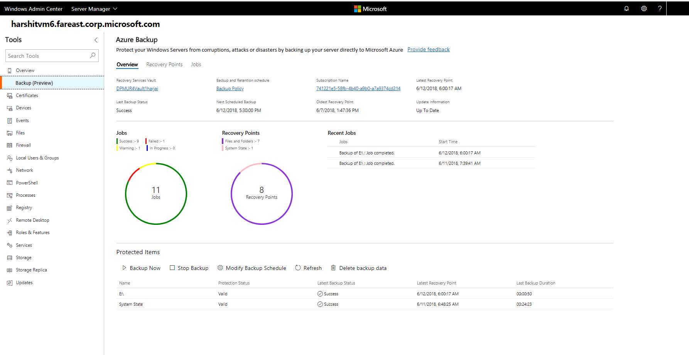
Natively integrated Azure backup
Windows admin center
Single browser-based view
of Windows Server workloads running on-premises and
in Azure
Seamlessly integrated with Azure services, simplifies
setup and status checks
Notes:
Windows Admin Center serves as the on-ramp for on-premise machines that use Azure services. It is separate from the Azure portal, which will be used for management, monitoring, and configuration after the initial setup flow.
Streamline and automate setup experience
WAC automates the manual steps required to connect on-premise machines to Azure services. This includes automatically installing any necessary agents on target machines, provisioning the Azure resources, and guiding users through initial configurations (streamlining where possible with default configurations and policies or smart suggestions).
View high-level statuses and connect through deep links to Azure portal for management
Users can see a high-level status of the health of the Azure service states (healthy, warning, critical error). For more detail about the status of the service or perform any management or detailed configuration tasks, you can click through to the Azure portal.
Example: Azure Backup
With Windows Admin Center, you can restore and perform actions against recovery points. You can continue to use the Azure portal to manage servers at scale and view aggregated information for monitoring jobs and alerts using deep links.

Slide 12
We need better security solutions
“How do we stay
ahead of emerging security exploits?”
“How do I
keep virtualized workloads safe?”
IT
$141*
Average amount paid
in USD for each lost
or stolen record containing sensitive or
confidential information
$3.62million*
Average total cost
of a data breach
*Cost of data breach study: Global analysis, 2017, Ponemon Institute
Notes:
Security continues to be a top priority for our customers. The number of cyber-security incidents continue to grow, and the impact of these incidents is escalating quickly.
Few organizations have the resources to stay ahead of emerging security exploits.

Slide 13
Enhanced security capabilities
Protect your datacenter with Windows Server 2019
Manage privileged identities
  Give administrators and system components just enough access privilege with Just Enough Administration
Secure the operating system
  Discover and address security breaches with Windows Defender Advanced
  Threat Protection
  Help prevent host intrusion with Windows Defender Exploit Guard
Secure virtualization fabric
  Run Linux inside a protected virtual machine with Shielded VMs for Linux
  Protect network traffic with the flip of a switch with Encrypted Subnets
Notes:
We continue on our journey to help our customers improve their security posture by working on features that bring together learnings from running global-scale datacenters for Microsoft Azure, Office 365, and several other online services.
Privacy and compliance concerns are one reason some organizations choose to keep data on-premises. Now organizations with intellectual assets on-premises can benefit from Microsoft expertise and broader support for Linux. Windows Server shares code and strong security features with the Windows platform and benefits from annual Microsoft security investment of $1 billion.
Manage privileged identities. Many breaches can be prevented by protecting administrator credentials. Windows Server 2019 ensure that all apps and system components have just enough access privilege.
Secure the operating system. Discover and address security breaches with integrated Windows Defender Advanced Threat Detection. Help prevent host intrusion with Windows Defender Exploit Guard, which locks down devices against a wide variety of attack vectors and blocks behaviors commonly used in malware attacks.
Secure virtualization fabric. Protect VM workloads from unauthorized access, with Shielded Virtual Machines for Windows Server or Linux workloads. Add another layer of protection for network traffic to and from a VM with Encrypted Subnets.

Slide 14
We need better datacenter scale and speed
“How do I simplify
my ability to
expand and scale operations?”
“How do I get a
single management
view across compute,
storage and networking?”
IT
Notes:
For datacenters to remain a critical part of an organization’s strategy, some basic changes are necessary.

Slide 15
Windows Server 2019
Unprecedented hyper-converged infrastructure
Industry leading performance
Microsoft-validated solutions ready to go
Simplified management
Notes:
Hyper-converged infrastructure (HCI): HCI is one of the latest trends in the server industry today. Organizations are embracing the trend for cost and performance reasons. They understand the value of using x86 servers with high performant local disks to run their compute and storage needs at the same time. In addition, HCI gives the flexibility to easily scale such deployments.
In hyper-converged deployments, compute, storage, and networking are on the same cluster, simplifying configuration and reducing hardware costs.

Slide 16

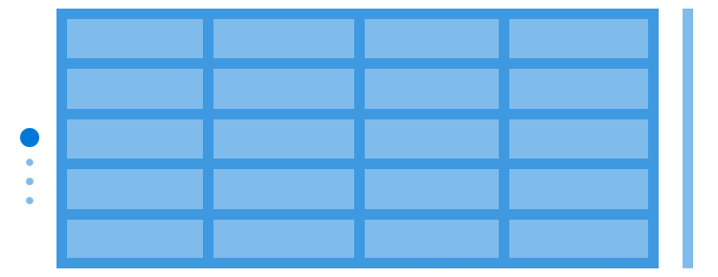
Traditional three-tier infrastructure
Ethernet switches
Misc. appliances
Hypervisors
Storage fabric
Storage (SAN)
Notes:
Let’s take a look at what changes.

Slide 17

Older three-tier infrastructure
Hyper-converged infrastructure (HCI)
Ethernet switches
Misc. appliances
Ethernet switches
Hypervisors
Standard x86 servers
+
Local drives
+
The magic of software
Storage fabric
Storage (SAN)
Legacy “Three Tier” Infrastructure
Hyper-Converged Infrastructure (HCI)

Slide 18
Evolution of Windows Server hyper-converged
Storage
Spaces Direct
Software-defined
Networking
Hyper-V
Introduced in 2008,
ten years ago!
New in Windows
server 2016
New in Windows
server 2016
Foundation of our
hyperscale Azure cloud
In development for 5+
years at Microsoft
Foundation of Azure Stack
Inspired by Azure
Notes:
Hyper-converged features introduced in Windows Server 2016 helped changed the way IT pros scaled storage and compute, and technology in Windows Server 2019 delivers faster time to value.

Slide 19

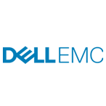


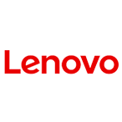




Accelerate your HCI deployment with WSSD
or
1
Build your own
2
Partner solutions
Http://aka.ms/WSSD
Notes:
You can build your own with Windows Server 2019.
Or you can get up and running quickly on a solution that's already built and tested by the partner of your choice.
Partners offer an array of Windows Server Software-Defined (WSSD) solutions that work with Window Server 2016 to deliver high-performance storage or hyper-converged infrastructure. The hyper-converged solutions bring together compute, storage, and networking on industry-standard servers and components, which means organizations can gain improved datacenter intelligence and control while avoiding the costs of specialized high-end hardware. All partner solutions are validated against our reference architecture as part of the Windows Server Software Defined (WSSD) program. Configurations are optimized for each partner's hardware.
Select the vendor that's the best match for you, with new partners joining the program all the time

Slide 20
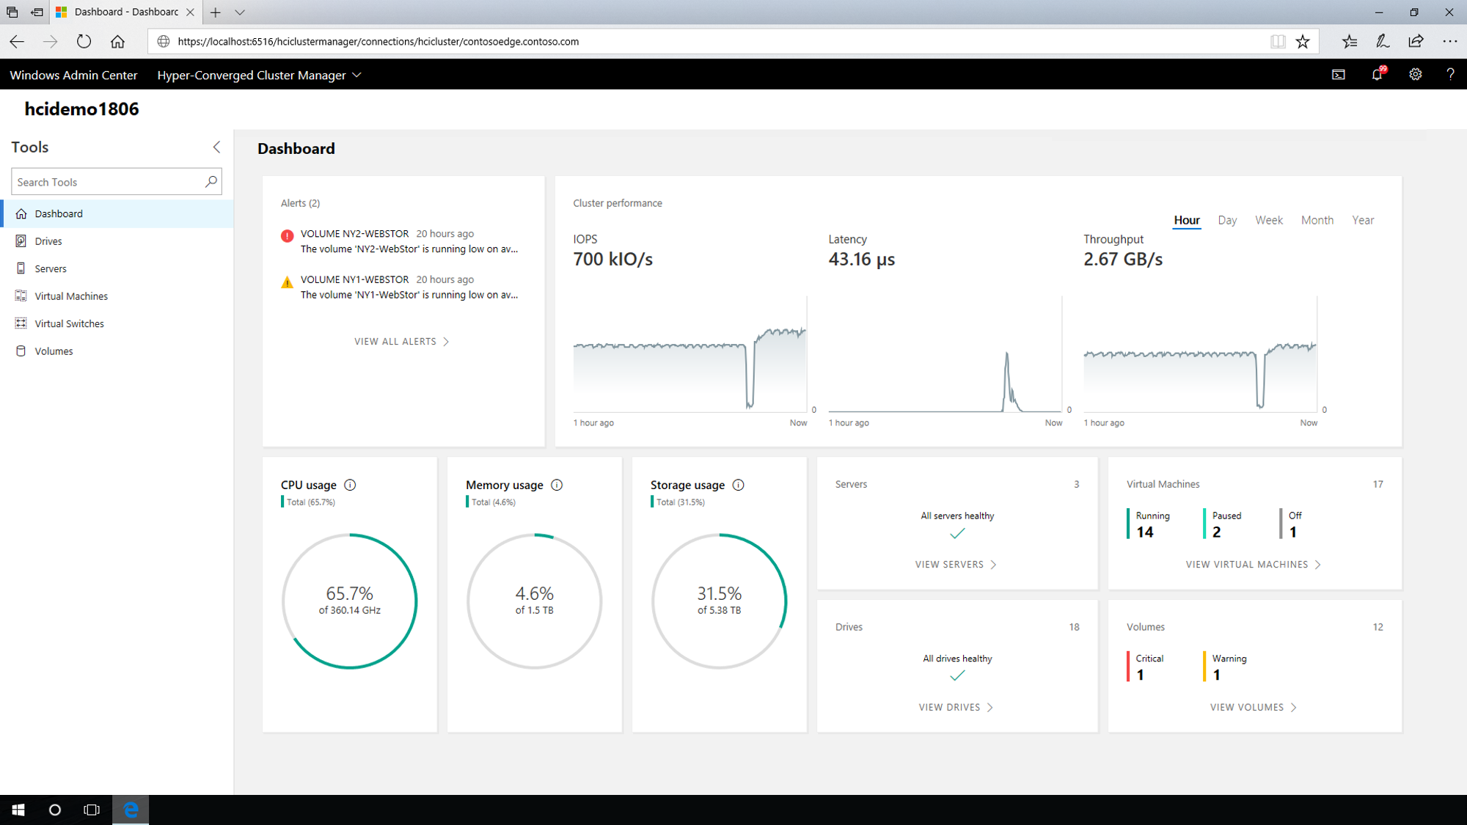
Simplified HCI management
Windows admin center
Manage Windows
Server HCI solutions for
Window Server 2016 or
2019
Hybrid Cloud integration built-in
Extensible to partners
Fine-tune solution performance
Notes:
Simplify daily management of HCI deployments with Windows Admin Center, an elegant, lightweight browser-based, locally-deployed platform that brings together your resources for visibility and action.
Hardware partners participating in the WSSD program are building extensions to the Windows Admin Center to help customers manage the solutions.

Slide 21
We need Dev and IT to work together
“How do I create
applications fast without worrying about the production environment?”
“How can I make
sure my new apps run
as expected on
production servers?”
How do I manage
servers and maintain compliance when we
are continuously deploying new code?”
Developers
Sarah Cooley
IT
Notes:
Developers and IT teams sometimes have different perspectives about how app innovation works best.

Slide 22
Windows Server 2019
Faster innovation for applications
Improved container support
Notes:
Both developers and operations need a modern platform that helps them deliver innovation at the rate of changing business demands.

Slide 23
Containers bring Dev and Ops together
Empower developers to create innovative applications fast
…without disrupting IT’s ability to manage servers and maintain control
Notes:
Containers are attractive for developers and for IT and can help them work as a team.
When you use containers to move your traditional applications into a modern DevOps environment with little or no code changes, you gain benefits such as consistency across dev, test, and production using the same tooling, which enables rapid deployments, continuous integration and continuous delivery, all with better security.
Containers are great for a number of reasons:
Fast iteration: Containers allow for rapid iteration through the development process both because they are lightweight and because of the way the application is packaged with its dependencies
Defined state separation: Changes to the container don’t affect other containers.
Resource controls: The host controls how much of the host’s resources can be used by a container. Governing resources like CPU, RAM and network bandwidth ensure that a container gets the resources it expects and that it doesn’t impact the performance of other containers running on the host.
Immutability: Changes made within one container won’t affect containers running on the same host.
Rapid deployment: Since containers are lightweight in terms of resources, they are easy to move, copy, and share. This enables rapid application deployment.

Slide 24
Containers are central to DevOps collaboration
Developers build, test and update apps in containers,
using development environment; i.e., Visual Studio
Operations automates deployment and monitors deployed apps from central repository
Developers push containers to central repository
Operations collaborates with developers
to provide app metrics and insights
Notes:
What does a DevOps lifecycle look like?
Firstly, developers build and test their applications, in containers, on their own box. This could be using a development environment like Visual Studio, or one from a 3rd party. You’ll see in this case, there is a couple of different containers, perhaps representing 2 tiers of an application or workload.
Once completed, these containers are pushed to central repository.
Operations automates deployment of the containers, from this central repository, to the target machines, which could be physical or virtual. They continue to monitor the containers…
…and collaborate with developers to provide them with insight and monitoring metrics which help the development teams gain insight into the usage of the applications.
This could be used to drive an update to a particular container, which, with the developers perform on their own boxes, iterate a version, and deploy the updated version to the central repository, which in turn, is then used to update the existing deployed containers. They could also, if they wanted, to roll it back to a previous version. Containers provides considerable flexibility in this space.

Slide 25
Faster innovation for applications
Enable developers and IT pros to build and refactor apps faster
Improved container support
  Optimized images for Server Core and Nano Server
  Easy options for running Windows or Linux containers
  Integrated with the container ecosystem
Improved support for container orchestration
  Kubernetes support—improvements to compute, storage and networking components of a Kubernetes cluster
  Red Hat open-shift container platform
Notes:
Windows Server 2019 meets the needs of developers and IT operations that want to support fast innovation with improved support for containers and Linux.
Modernize apps faster with container support. Windows Server 2019 delivers a smaller Server Core container image for speedier download and offers enhanced support for compute, storage, and networking of Kubernetes clusters and the Red Hat OpenShift Container Platform.
Improve Linux operations. Building on previous support to run Linux and Windows containers side by side, Windows Server 2019 reduces complexity by enabling developers to use standard tools such as Open SSH, Curl, and Tar.

Slide 26
We live in a cross-platform world
“I really want to try Terraform with the Ansible plugin.”
“Stack Exchange suggests I try this bash script with sed, awk, and grep.”
Ops
Notes:
Windows offers a broad array of technologies for dev-ops but there are many reasons why you may want to run a Linux native tool
Linux-native tools play a huge part of the container ecosystem. There are also very useful for CI/CD pipelines.
Some things are released for Linux first or have different functionality.
Documentation platform mismatch.

Slide 27
Windows Server 2019
Run any dev tool - Windows or Linux
Improved Linux support
Notes:
Both developers and operations need a modern platform that helps them deliver innovation at the rate of changing business demands.

Slide 28
Real Linux
Distributions
Light weight
experience
Integrated
with
Windows
Choose from several Linux distributions.
Same tools and package managers.
Not recompiled.
No overhead for a virtual machine (~300MB).
Shared files and devices.
Mix and match Linux and Windows command line tools
Notes:
https://docs.microsoft.com/en-us/windows/wsl/install-on-server

Slide 29
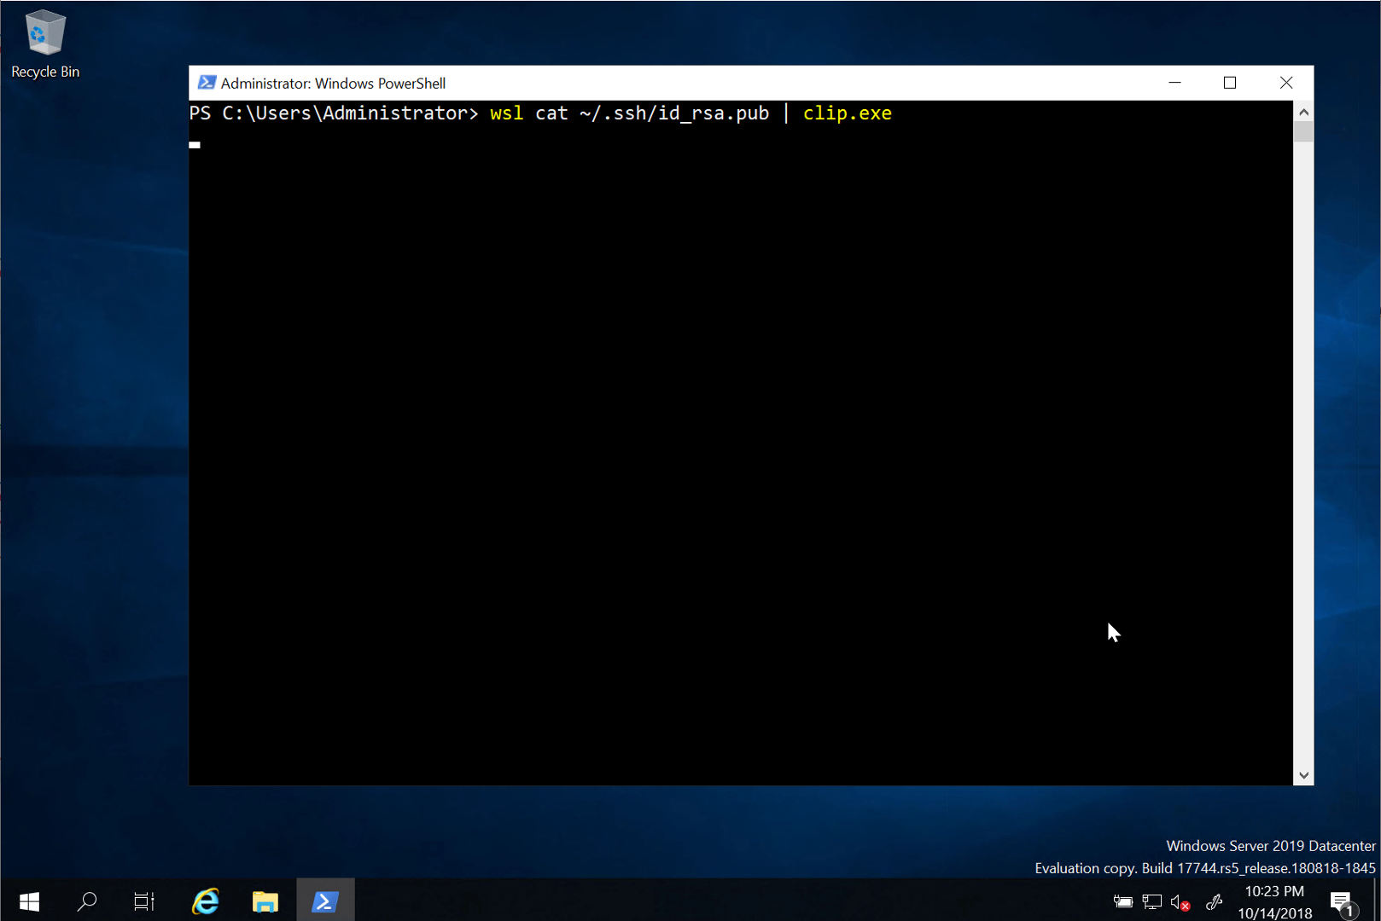
Demo!
Notes:
https://docs.microsoft.com/en-us/windows/wsl/install-on-server

Slide 30
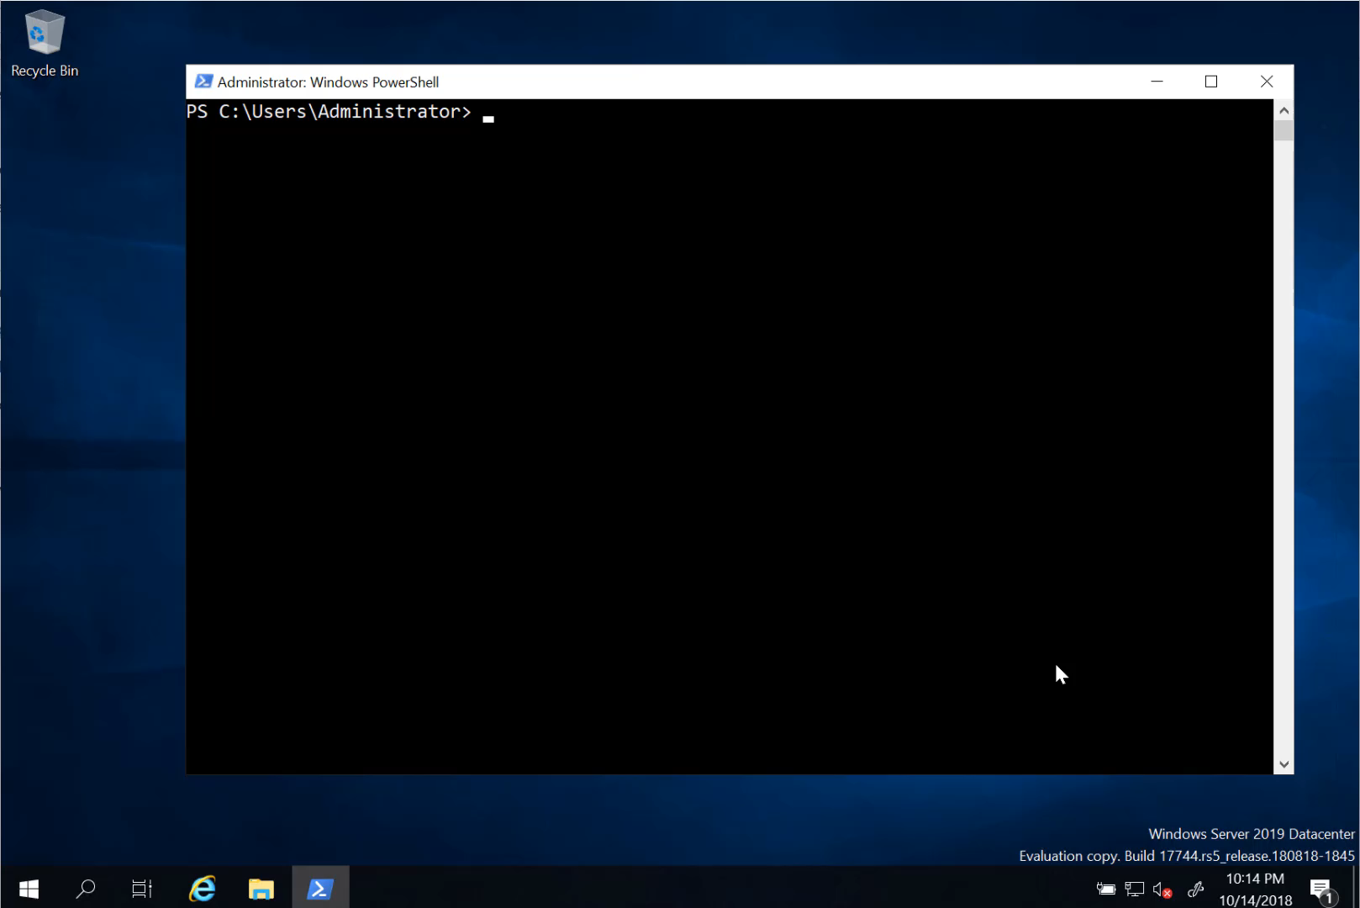
Notes:
https://docs.microsoft.com/en-us/windows/wsl/install-on-server

Slide 31
What about…
Identity
  WSL uses a different identity for your Windows and Linux user. Linux distros have a separate username and password.
Security
  WSL respects both Windows and Linux security constructs. Linux will ask for elevation where needed and WSL will run with the permissions from starting context.

Slide 32
Popular Linux tools in Windows 2019
Many Linux-native tools are already built in
  BSD tar, curl, dtrace
  Open SSH and SSH server
Better support for popular tools
  Git for Windows + Windows credential manager
  VSCode + Azure and Azure CLI
  Azure CLI

Slide 33
Windows Server 2019
Unique hybrid capabilities with Azure
Advanced multi-layer security
Faster innovation
for applications
Unprecedented
hyper-converged infrastructure
Notes:
Windows Server 2019 is the operating system that bridges on-premises and cloud.
Extend your datacenter to Azure to maximize existing investments and gain new hybrid capabilities.
Elevate your security posture by protecting the datacenter starting with the operating system
Enable Developers and IT Pros to create cloud native, modernize their traditional apps using containers and microservices
Evolve your datacenter infrastructure to achieve greater efficiency and security.

Slide 34
This is how you get the fast innovation
Long-term servicing channel
  Windows
  server 2016
  Windows
  server 2019
October 2016
H2 2018
October 2017
April 2018
H2 2018
  Windows server,
  version 1709
  Windows server,
  version 1803
  Windows server,
  version 18XX
Semi-annual channel
Notes:
Customers that want fast innovation choose the Semi-Annual Channel as the servicing option versus the more traditional Long-Term Servicing Channel (LTSC).
The Semi-Annual Channel offers a release every six months, with 18 months of support. Each release will build on the prior one and add new capabilities. In contrast, LTSC offers releases every two to three years, and includes five years of mainstream support and five years of extended support. Semi-Annual Channel capabilities are eventually rolled into a future Long-Term Servicing Channel release.
The Semi-Annual Channel works well for customers that are innovating quickly in applications, particularly those built on containers and microservices architectures, plus customers moving to a software-defined hybrid datacenter. If you don’t have Software Assurance active for your Windows Server licenses, you can use the Semi-Annual Channel images available in the Azure marketplace or images provided by your cloud service provider.

Slide 35
Options to get cloud ready
Transform with Azure
On-premises
Rehost
Migrate Windows server
2008 and 2008 R2
workloads to Azure VM
Refactor, rearchitect,
or rebuild
Innovate with Windows
server containers
and Azure services
Upgrade
Upgrade to Windows
server 2019 and get
cloud and DevOps ready
Notes:
Organizations have options. Each is worth exploring and you may use multiple options to move workloads from Windows Server 2008, depending on the workload.
Do you want to keep the workload on-premises or move to the cloud?
Can you upgrade the operating system or do you 100% need to stay on Windows Server 2008?
Do you want rebuild the application using new app patterns with Azure PaaS – or simplify containerize to lift and shift with minimal code changes?
If you must stay on Windows Server 2008, there’s one option that doesn’t open you up to major security and compliance issues – we’ll discuss that later.
Otherwise, you can choose:
Move to Azure by choosing to Rehost, Refactor, or Rebuild your workload or app.
Or Upgrade on premises to the latest version of Windows Server.

Slide 36

Options to manage end of support for 2008 and 2008 R2 workloads
  Transform with Azure
  Upgrade on-premises
Migrate applications to Azure VMs
Get 3 years of extended security updates for Windows Server 2008 and 2008 R2 at no additional charge
Migrate data to Azure managed instances or VMs
Azure managed Instances offers a version-free option
Azure virtual machines include 3 more years of extended security updates for SQL server 2008 or 2008 R2 at no additional charge
Modernize when ready
Upgrade in Azure when ready
Or transform apps and data with Azure services
Upgrade to latest version
Windows Server 2016 or 2019
SQL Server 2016 or 2017
Can’t meet the deadline?
Buy extended security updates to get 3 more years of security updates for Windows Server and SQL server 2008 or 2008 R2
Upgrade when ready
or

Slide 37

Get started
  Download Windows
  server 2019 preview
  http://aka.ms/WS2019Preview
  Download Windows
  admin center http://aka.ms/WindowsAdminCenter
  Check out the
  WSSD program
  http://aka.ms/WSSD
  Download WSL
  http://aka.ms/InstallWSL

Slide 38
Appendix

